Slide 1
CIS CONTROL 14: CONTROLLED ACCESS-NEED TO KNOW-I
CONTROLLED ACCESS BASED ON THE NEED TO KNOW

Slide 2
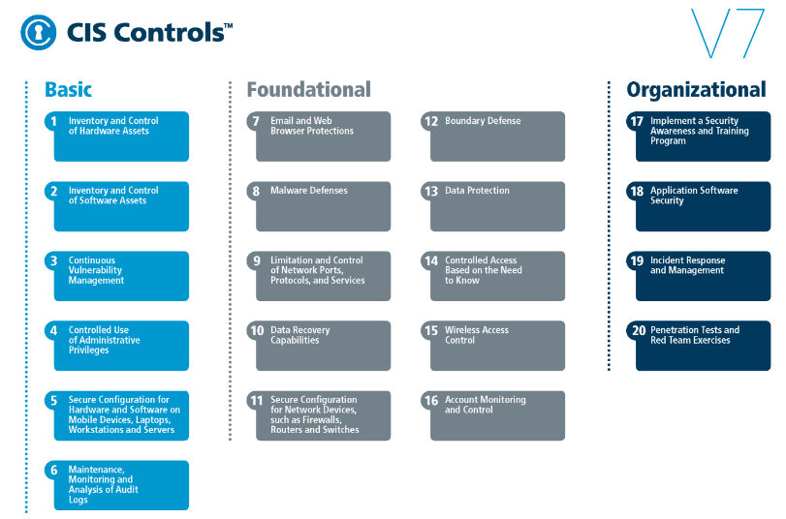
CIS CONTROL 14: CONTROLLED ACCESS-NEED TO KNOW-I
https://www.cisecurity.org/controls/

Slide 3
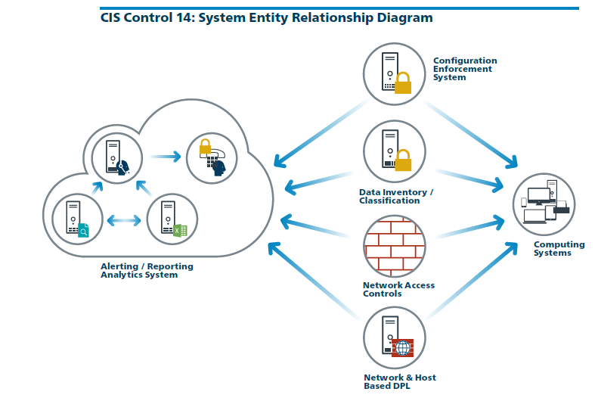
CIS CONTROL 14: CONTROLLED ACCESS-NEED TO KNOW-I
https://www.cisecurity.org/controls/

Slide 4
CIS CONTROL 14: CONTROLLED ACCESS-NEED TO KNOW-I
14.1: Segment the Network Based on Sensitivity
Segment the network based on the label or classification level of the information stored on the servers, locate all sensitive information on separated Virtual Local Area Networks (VLANs).

Slide 5
CIS CONTROL 14: CONTROLLED ACCESS-NEED TO KNOW-I
14.2: Enable Firewall Filtering Between VLANs
Enable firewall filtering between VLANs to ensure that only authorized systems are able to communicate with other systems necessary to fulfill their specific responsibilities.

Slide 6
CIS CONTROL 14: CONTROLLED ACCESS-NEED TO KNOW-I
14.3: Disable Workstation to Workstation Communication
Disable all workstation to workstation communication to limit an attacker's ability to move laterally and compromise neighboring systems, …

Slide 7
CIS CONTROL 14: CONTROLLED ACCESS-NEED TO KNOW-I
14.3: Disable Workstation to Workstation Communication
…through technologies such as Private VLANs or microsegmentation.

Slide 8
CIS CONTROL 14: CONTROLLED ACCESS-NEED TO KNOW-I
14.4: Encrypt All Sensitive Information in Transit
Encrypt all sensitive information in transit.

Slide 9
CIS CONTROL 14: CONTROLLED ACCESS-NEED TO KNOW-I
14.5: Utilize an Active Discovery Tool to Identify Sensitive Data
Utilize an active discovery tool to identify all sensitive information stored, processed, or transmitted by the organization's technology systems, including those located…

Slide 10
CIS CONTROL 14: CONTROLLED ACCESS-NEED TO KNOW-I
14.5: Utilize an Active Discovery Tool to Identify Sensitive Data
… onsite or at a remote service provider and update the organization's sensitive information inventory.
END

